Slide 1
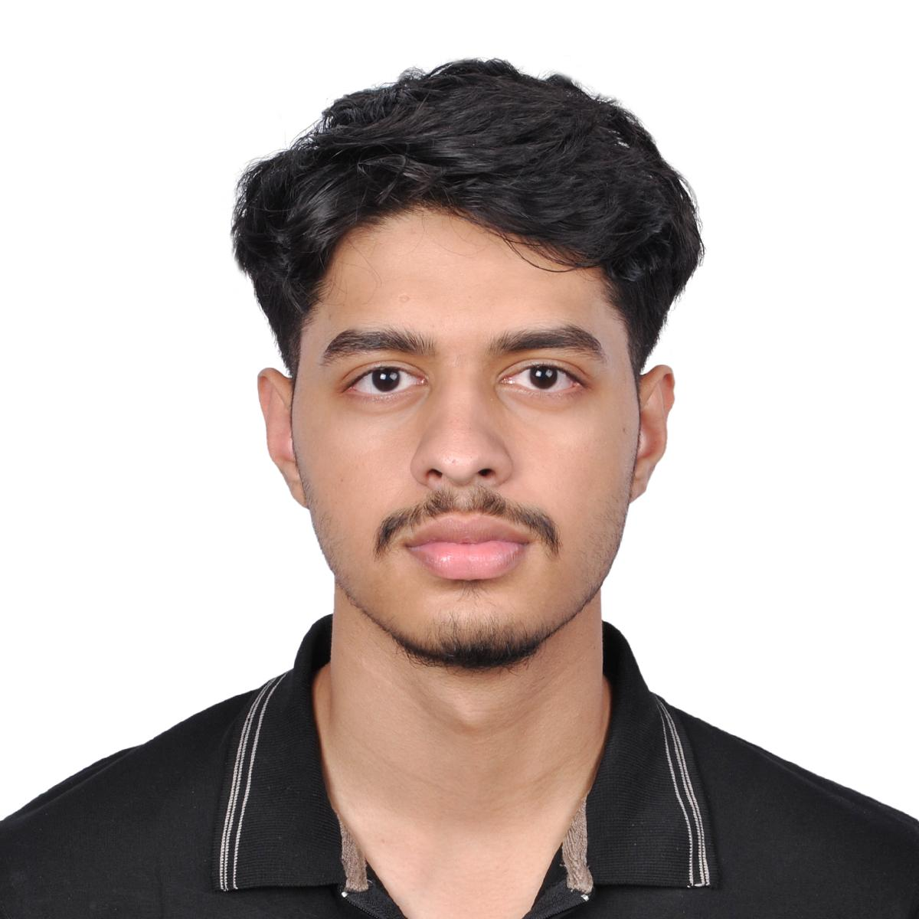
Professional portfolio:
Business & Artificial intelligence
Name: Mohammad Uraib
Program: Business and Artificial Intelligence
Career Goal: Data Analyst using AI-driven tools
GitHub Portfolio: https://github.com/uraib786/Mohammad-Uraib-AI-Portfolio-

Slide 2

Learning journey
Project Experience:
Digital collage project (English 1301)
Personal life journey presentation (Educational Frameworks)
Group AI project (Deep Learning)
Courses Completed:
Mathematics for Social Science and Business
Deep Learning
English 1301
Educational Frameworks
Technologies Learned:
Python programming
Google Collab
Basic machine learning concepts

Slide 3
Projects
Project 1:
Digital Collage – English 1301
Created a visual collage using Canva to communicate personal and academic themes.
Tools Used: Canva
Project 2:
AI Group Project – Deep Learning
Built and tested machine learning models using Google Collab to solve data-based problems.
Tools Used: Python, Google Collab, Machine Learning
Project 3:
My Life Journey Presentation – Educational Frameworks
Designed a structured presentation reflecting learning growth and career goals.

Slide 4
Skills and competencies
Technical Skills
Python programming
Google Collab for AI model development
Machine Learning fundamentals
Data handling and basic analytics
SOFT SKILLS
TEAM WORK
GROUP COLLABORATION
COMMUNICATION SKILLS
PROBLEM-SOLVING MINDSET
TIME MANAGEMENT

Slide 5
REFLECTION & FUTURE GOALS
Reflection:
Through my coursework and projects, I developed strong problem-solving skills and a foundation in artificial intelligence and data analysis.
Future Goals:
I plan to major in Artificial Intelligence and Business Technology and continue improving my coding skills to prepare for a career in AI-powered data analysis.

